Slide 1

Welcome! My name is Luca Fusar Bassini.
Computational biology PhD student
1
Freelance podcaster and scicomm writer
2
Traveller, volunteer, amateur photographer
3
Follow me on LinkedIn (Luca Fusar Bassini) and GitHub (@lucafusarbassini)

Slide 2
1. Notebook!
https://github.com/LauzHack/apis-telegram/blob/main/
Tutorial_APIs_LFB.ipynb

Slide 3
2. PaperBoat

Slide 4
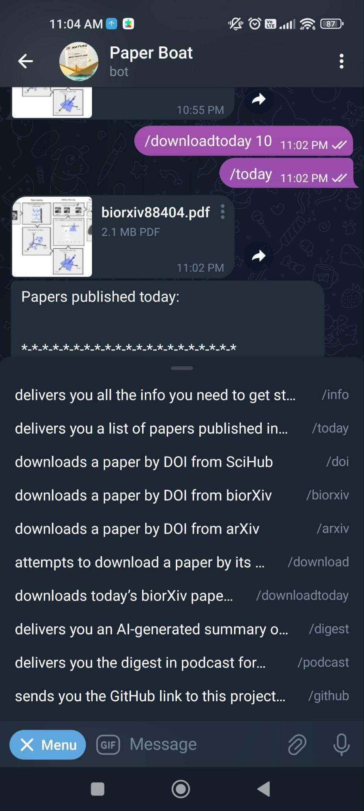
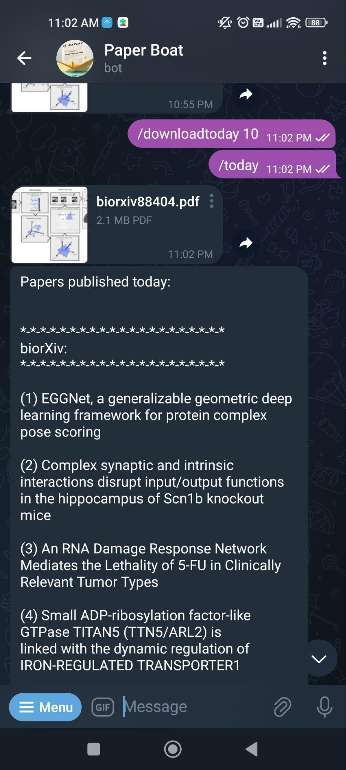
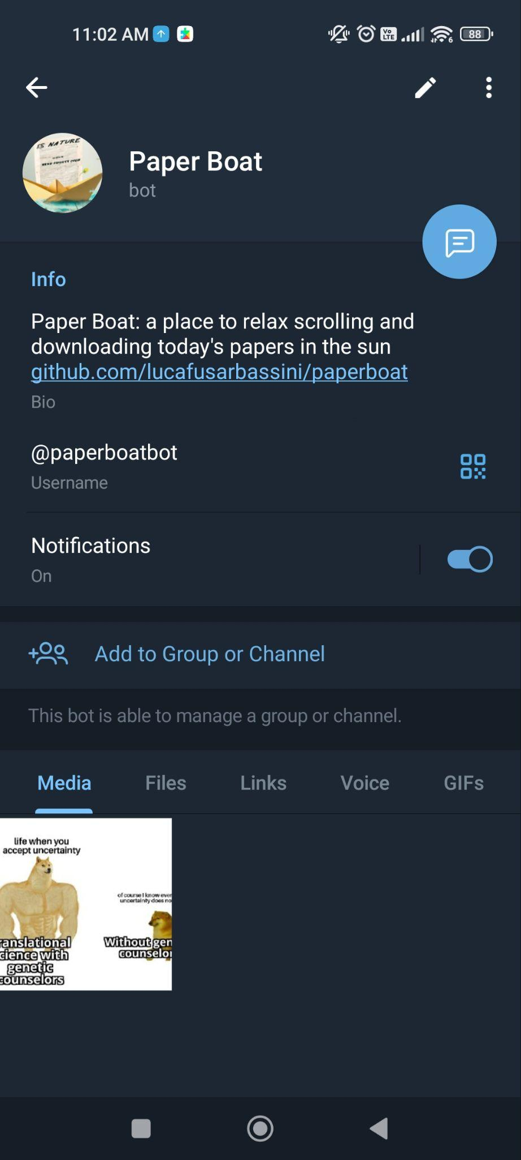
PaperBoat now

Slide 5
A few ideas to implement!
Reduce information overload by sub-selecting papers for topic and relevance a. A user-centric paper ranking b. Topic detection Idea: use BERT + build dataset with "all" published literature with zotero to be used for fine-tuning c. LLMs to detect innovative research vs most less-innovative papers
[implemented but $$] ChatGPT-based 3-phrases summaries for (at least) top daily papers
[implemented but $$] Explain abstracts in simple terms (ChatGPT-based)
Function to return authors' names from paper's title or DOI
Differentiate papers vs reviews, commentaries, etc
User-centric message scheduler (eg, receive Nature Biotech updates on a weekly basis on Friday)
Deliver DOI links to papers published today (not yet listed on CrossRef)
Save relevant papers and preprints to collection / Zotero Zotero is currently integrated but with my own API key, and is able to put DOI and title only (no metadata creation like adding from web)
Performance (eg, conversion titles and DOIs is slow) + CrossRef API usage results in mistakes
Add the possibility to ask for imprecise titles and retrieve 2-3 closest approximation paper pdfs

Slide 6
More advanced ideas!
A text-to-voice AI narrator to make a podcast out of the daily papers you can easily listen at breakfast, walking or while coding - more like a story
Connections with LinkedIn/Twitter, and social media (eg papers from your niche and contacts)
Paper Boat wrap - weekly / yearly... for specific subsets: overall view of the field
Make it a website too (some people don’t have Telegram)
A recommendation engine / advanced ranking based on users history of downloads
A function to connect people who liked/saved the same papers
Integrate with Humata AI
Weekly relevance assessment based on overall user downloads, likes, forwarded etc – some sort of "decentralized peer review" or trend detection
Translation to users’ preferred language
[…]

Slide 7
Moral
ToDo
Today almost anything has an API - you can automate anything in workflows (eg also Google Sheets, Notion, Twitter… whatever you want!) - and easy to use as ChatGPT…
Send us your email address to be added to the OpenAI for the tutorial
Divide and conquer - organize tasks, talk, network, fork!

Slide 8
3. Getting an OpenAI API key + others

Slide 9
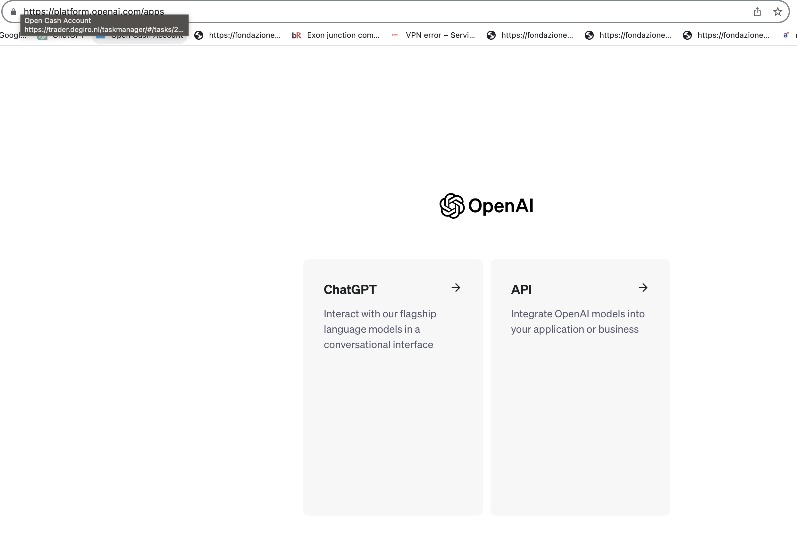

Slide 10
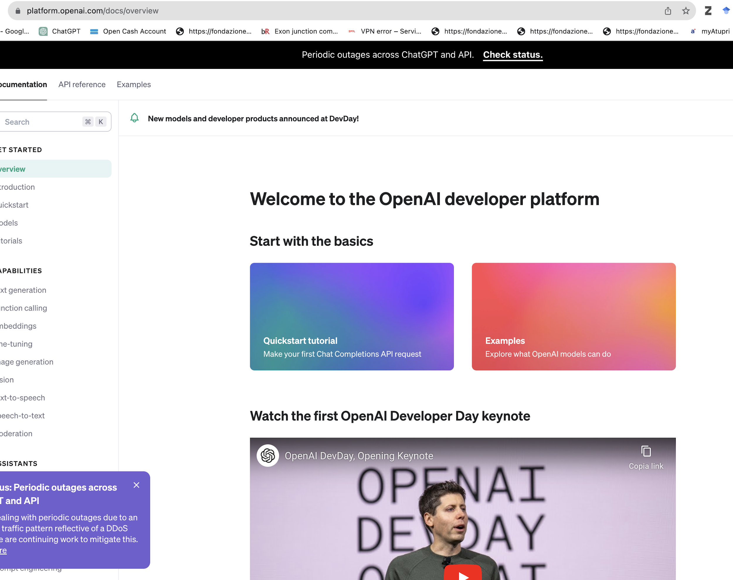

Slide 11
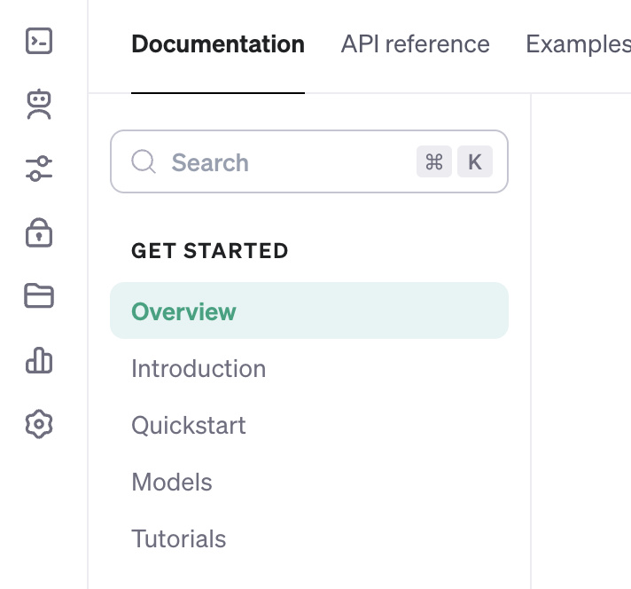

Slide 12
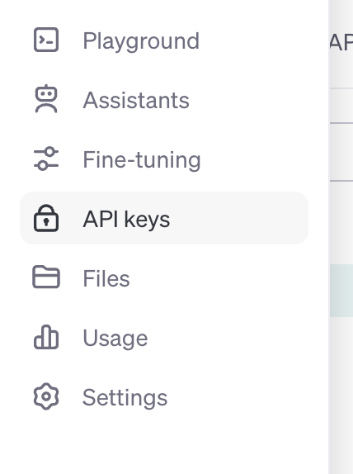

Slide 13
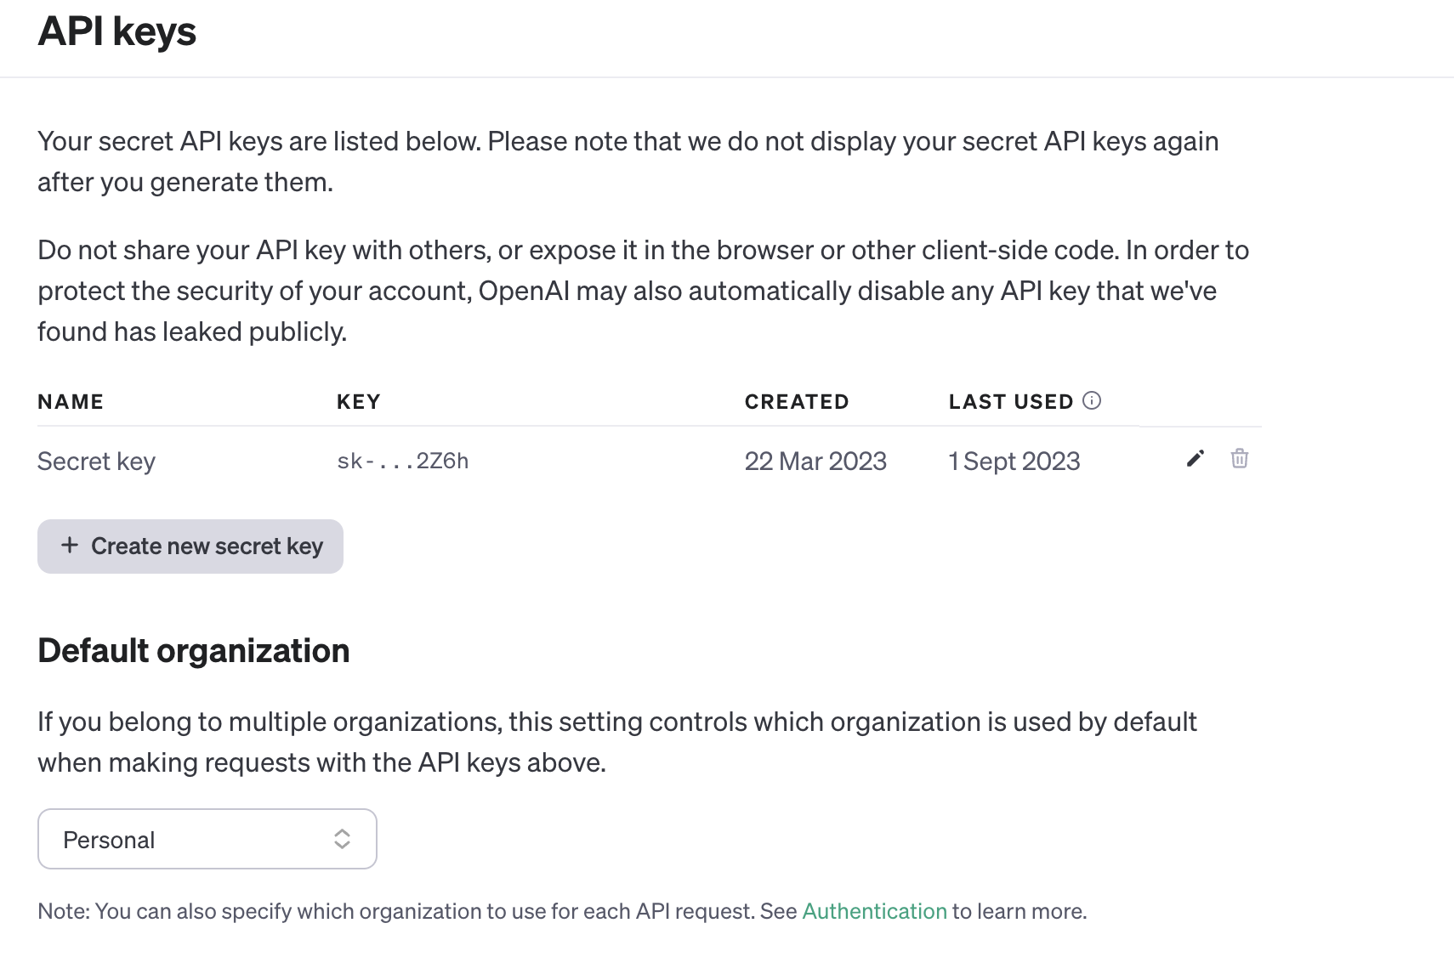

Slide 14
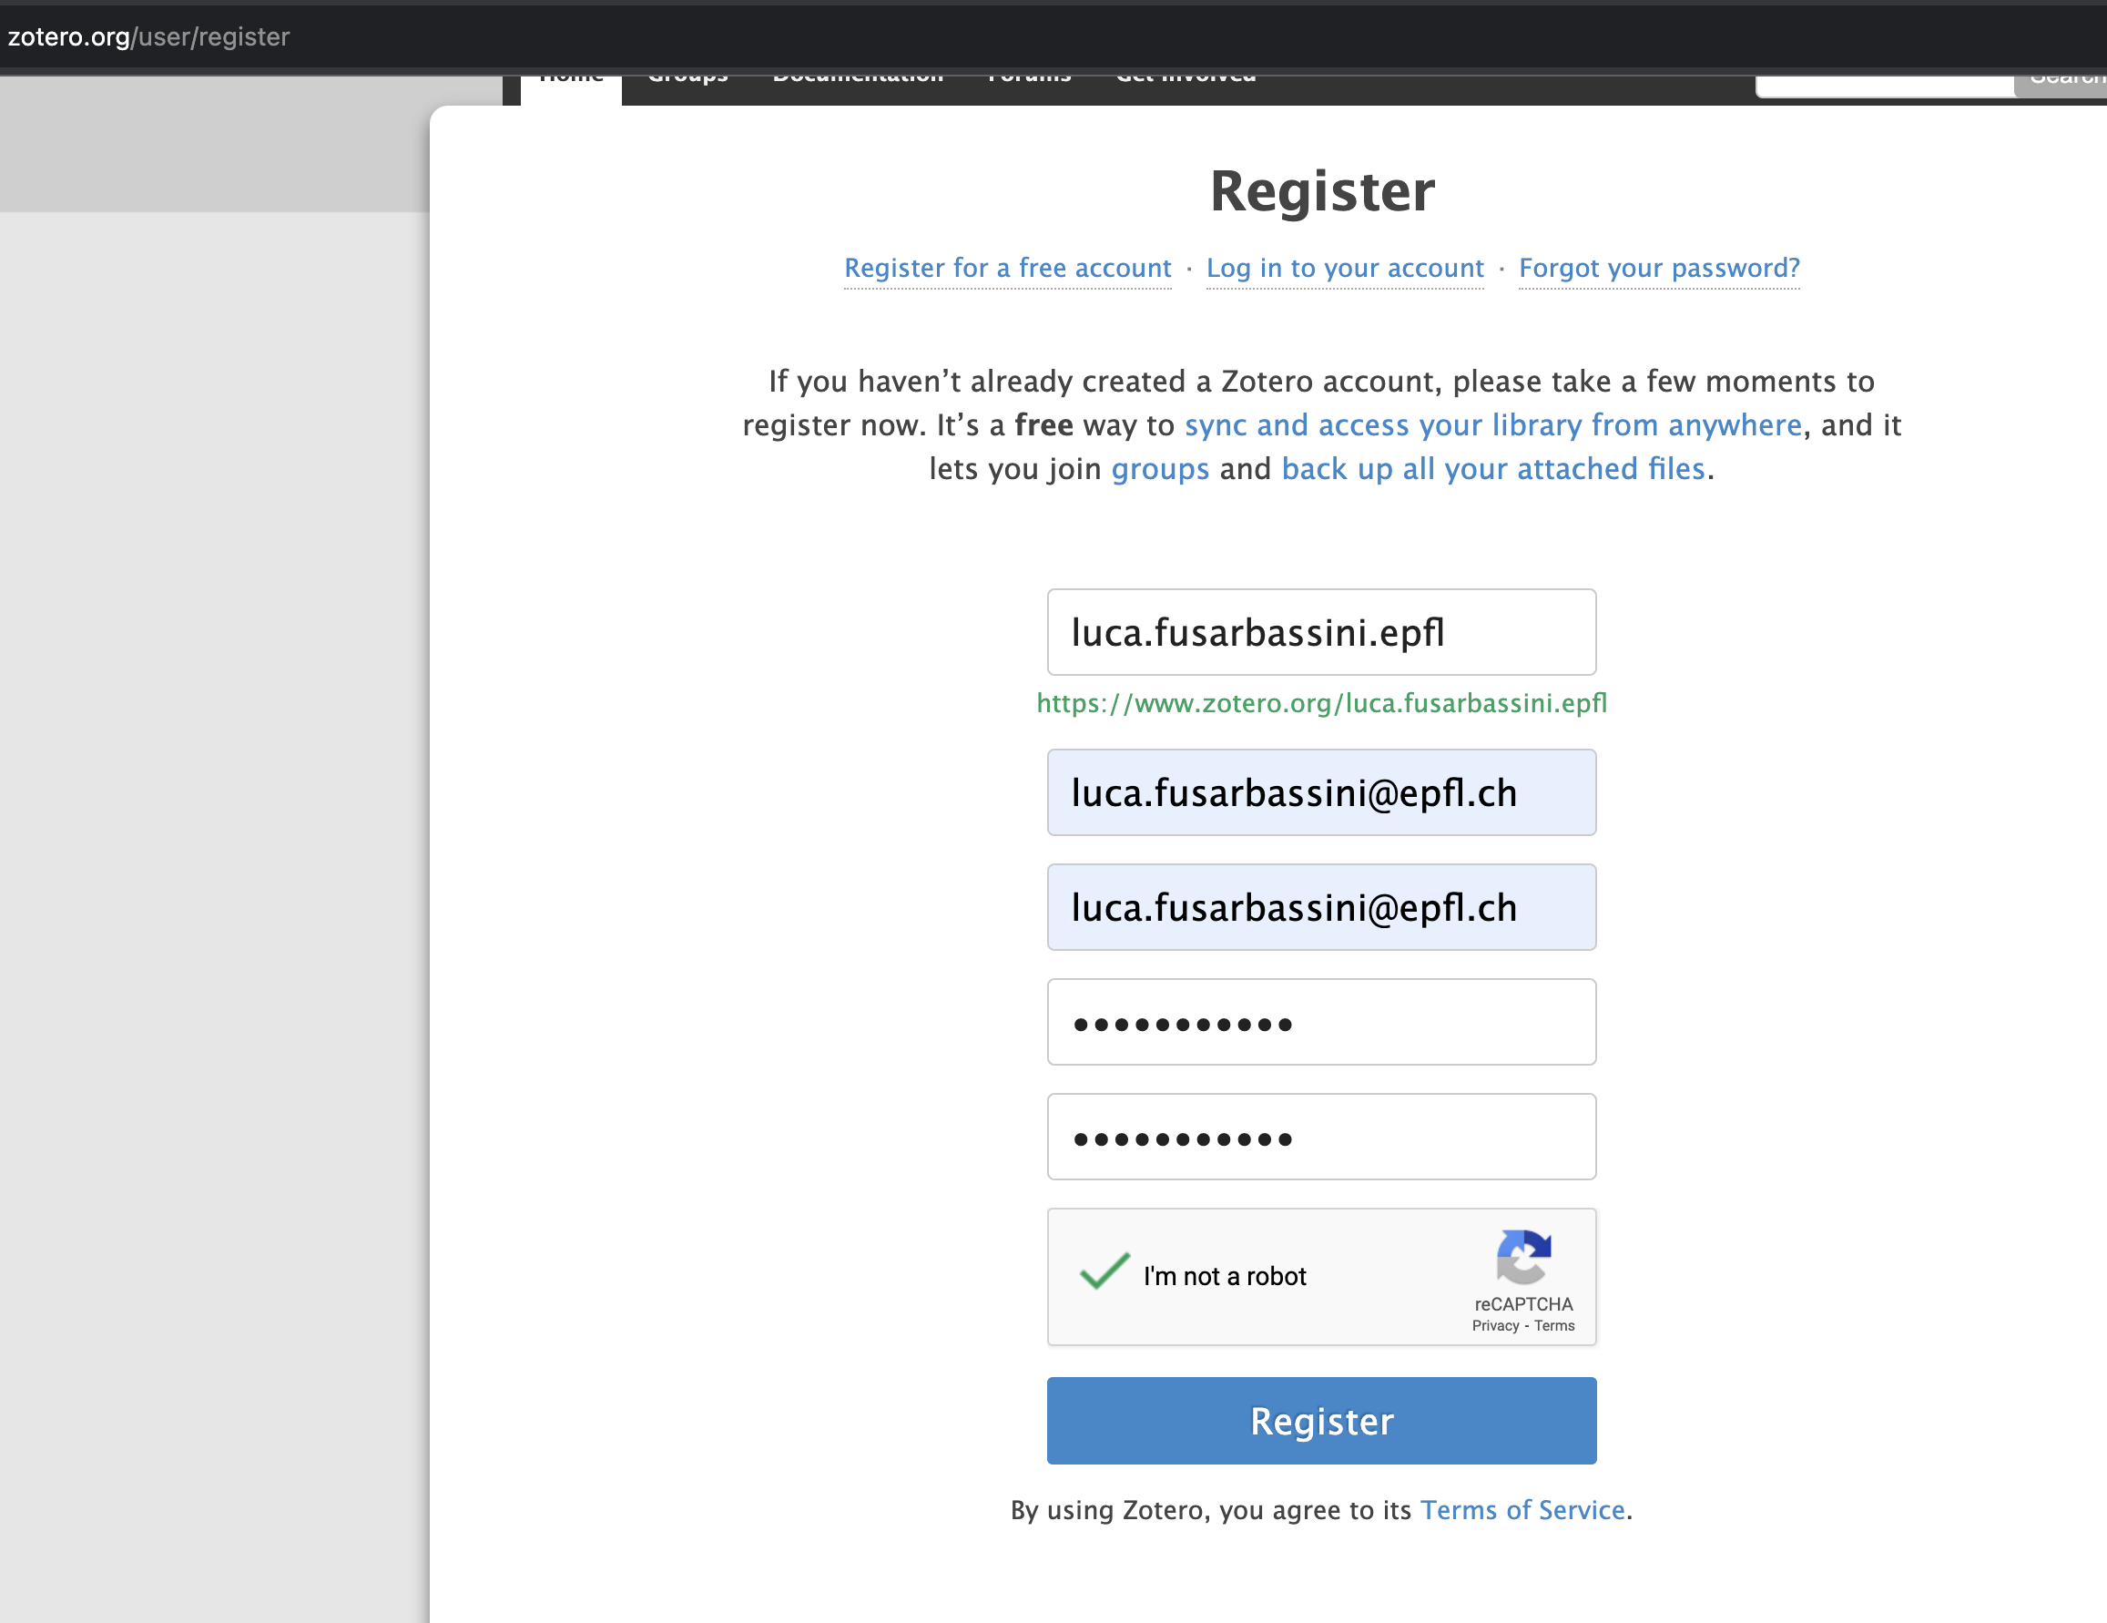

Slide 15
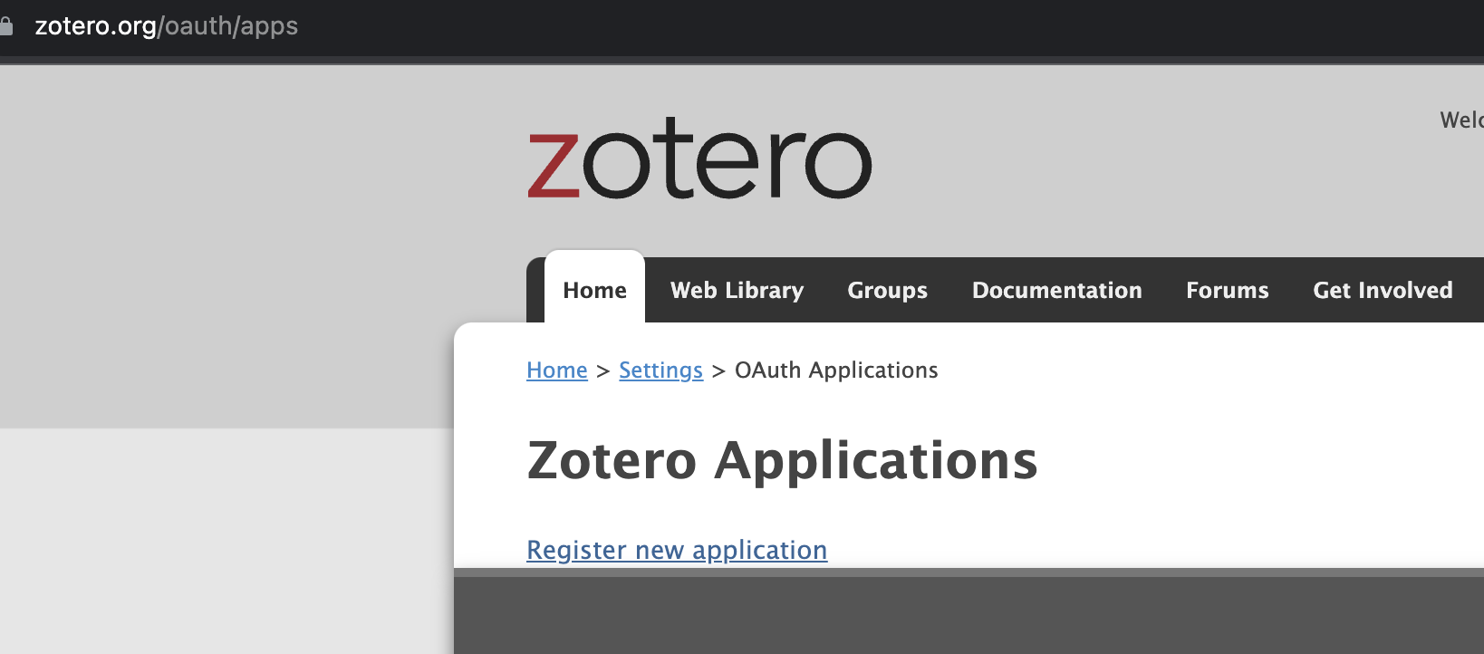

Slide 16
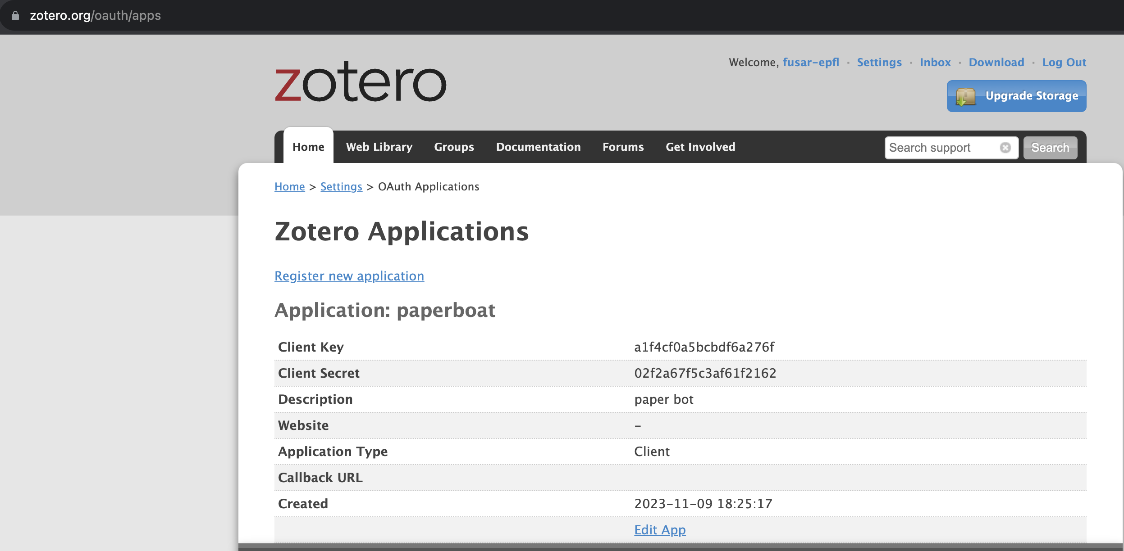

Slide 17
